Slide 1
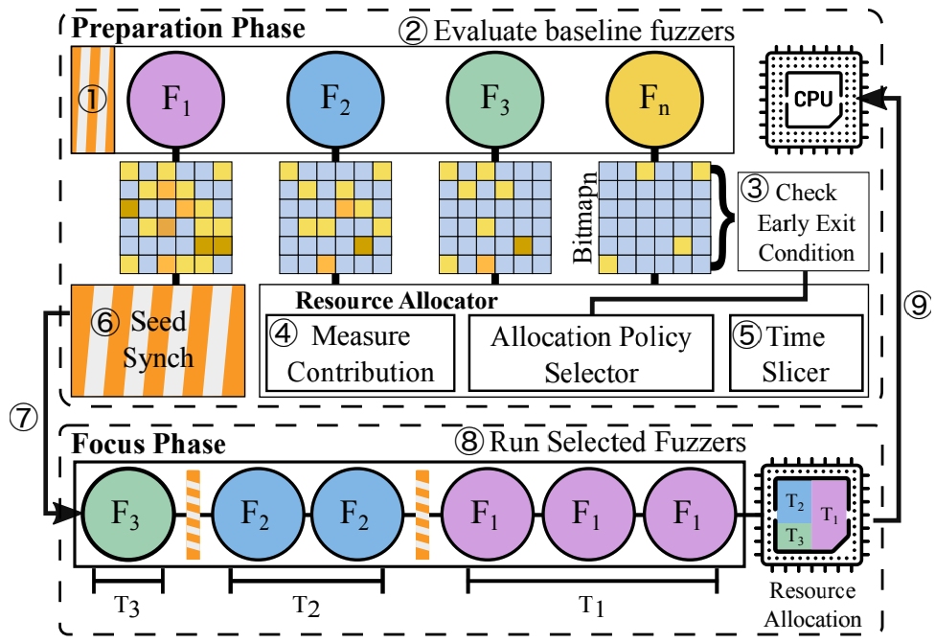

“ARMy Fuzzing”: Efficient Fuzzing on Commodity, Portable Devices
Kathryn Smith, Drew York
CPSC 8570-843

Slide 2

Research Motivations
Working Title: “ARMy Fuzzing:” Metrics for comparably Efficient Fuzzing on Commodity, Portable [ARM64] Devices.
Problem statement: We seek to confirm the effectiveness of autofz on commodity, portable ARM64 devices. We also seek to identify at least 1 alternate metric for efficient fuzzer selection.
Background: [4]
The popularity of fuzzing has grown over time, used to identify defects and even vulnerabilities in software.
Given diversity of fuzzers, selecting the best tool can be difficult.
YU-FU, F., LEE, J. AND KIM, T. 2023 proposed a tool, autofz, to achieve the most optimal fuzzing results from multiple fuzzing tools. Their work:
“dynamically deploy[s] different sets of fuzzers per workload based on the fuzzer evaluation[(AFL bitmap trends)] at runtime”
Require significant system resources (AMD Ryzen 9 3900 (12C/24T), 32 GB RAM, and 512 GB SSD disk space)
Uses one metric for fuzzer selection (AFL bitmap)
Demonstrated on x86_64/AMD64 architecture
Similar approach is collaborative fuzzing, which requires prior knowledge for selection
[1]

Slide 3
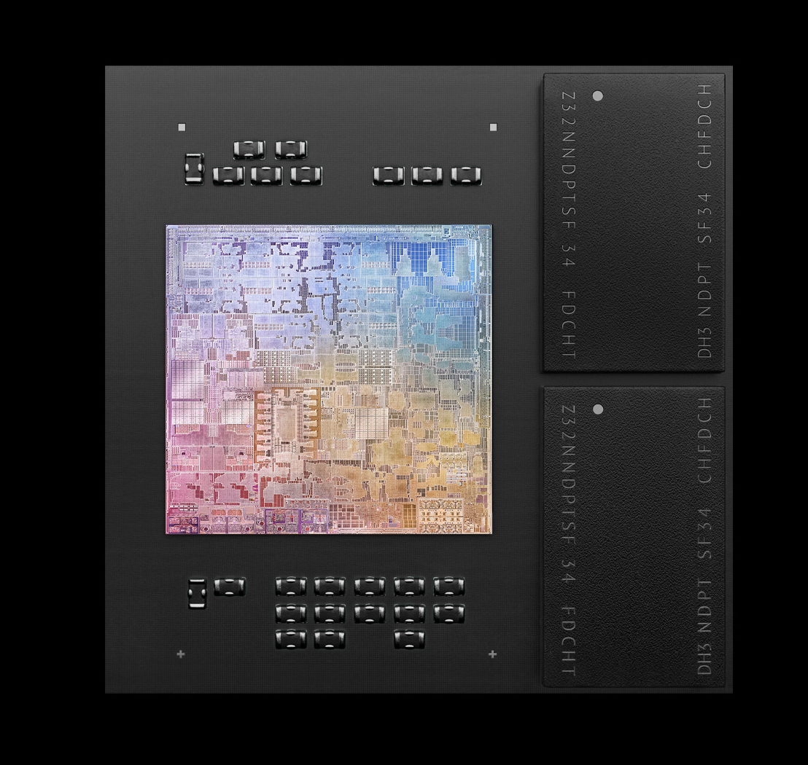
Research Plan
January/February 2024:
Rebuild autofz software in Ubuntu 22.04.3 LTS
Validate defect findings in at least two software packages in [4] YU-FU, F., LEE, J. AND KIM, T. 2023
Identify potential alternate metrics [3]; Identify any required external libraries
March 2024:
Present status and findings (March 5 – 7)
Evaluate performance and efficiency of alternate metric(s) against AFL bitmap trends
April 2024:
Complete Evaluations and Compile Results
Complete Paper and Presentation
Present Results (April 23 – 25)
May 2024:
Submit Paper (May 2)
[2]

Slide 4
References
[1] Anonymous 2019. AFL (american fuzzy lop). https://afl-1.readthedocs.io/en/latest/index.html.
[2] Anonymous 2020. Apple unleashes M1 . https://www.apple.com/newsroom/2020/11/apple-unleashes-m1/.
[3] ECEIZA, M., FLORES, J.L. AND ITURBE, M. 2023. Improving fuzzing assessment methods through the analysis of metrics and experimental conditions. Computers & security 124, 102946. https://dx.doi.org/10.1016/j.cose.2022.102946.
[4] YU-FU, F., LEE, J. AND KIM, T. 2023. autofz: Automated Fuzzer Composition at Runtime. arXiv.org .

